Slide 1
Network Commands

Slide 2
1. ifconfig
Linux ifconfig stands for interface configurator.
It is one of the most basic commands used in network inspection.
ifconfig is used to initialize an interface, configure it with an IP address, and enable or disable it.
It is also used to display the route and the network interface.
Basic information displayed upon using ifconfig are:
1. IP address 2. MAC address 3. MTU (Maximum Transmission Unit)
Syntax: ifconfig

Slide 3
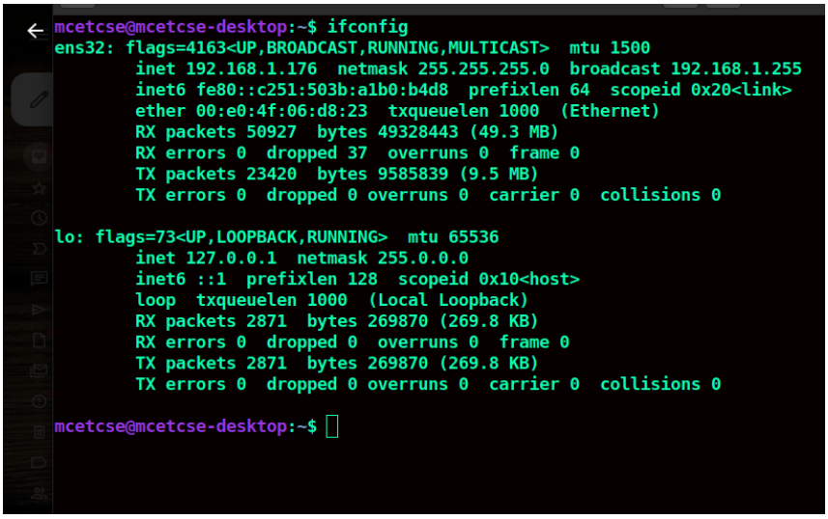

Slide 4
2. traceroute
Linux traceroute is one of the most useful commands in networking.
It is used to troubleshoot the network.
It detects the delay and determines the pathway to your target.
Syntax: traceroute <destination>
Example: $ traceroute google.com

Slide 5
3. tracepath
Linux tracepath is similar to traceroute command.
It is used to detect network delays. However, it doesn't require root privileges.
It is installed in Ubuntu by default.
It traces the route to the specified destination and identifies each hop in it.
If your network is weak, it recognizes the point where the network is weak.
Syntax: tracepath <destination>
Example: tracepath www.google.com

Slide 6
4. ping
Linux ping is one of the most used network troubleshooting commands.
It basically checks for the network connectivity between two nodes.
ping stands for Packet INternet Groper.
The ping command sends the ICMP echo request to check the network connectivity. It keeps executing until it is interrupted.
Use Ctrl+C Key to interrupt the execution.
Syntax: ping
Example: $ ping google.com

Slide 7
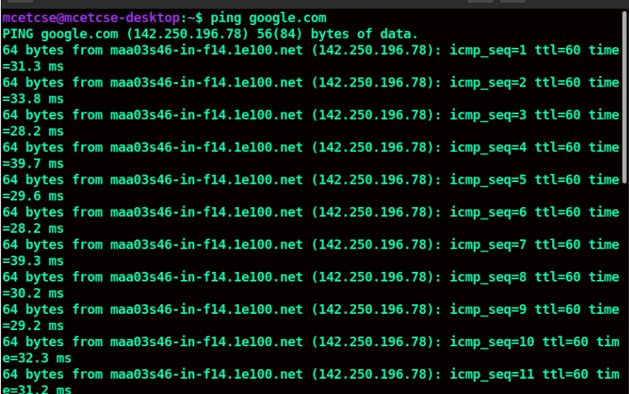

Slide 8
5. netstat
Linux netstat command refers to the network statistics.
It provides statistical figures about different interfaces which include open sockets, routing tables, and connection information.
Syntax: netstat –v
6. ss
Linux ss command is the replacement for netstat command.
It is regarded as a much faster and more informative command than netstat.
This command gives information about all TCP, UDP, and UNIX socket connections.
The faster response of ss is possible as it fetches all the information from within the kernel userspace.
Syntax: ss

Slide 9
7.dig
Linux dig command stands for Domain Information Groper.
This command is used in DNS lookup to query the DNS name server.
It is also used to troubleshoot DNS related issues.
It is mainly used to verify DNS mappings, MX Records, host addresses, and all other DNS records for a better understanding of the DNS topography.
This command is an improvised version of nslookup command.
Syntax: dig <domain name>
Example: dig geeksforgeeks.org

Slide 10
8. nslookup
Linux nslookup is also a command used for DNS related queries.
It is the older version of dig.
Syntax: nslookup
Example: nslookup www.google.com
9. route
Linux route command displays and manipulates the routing table existing for your system.
A router is basically used to find the best way to send the packets across to a destination.
Syntax: route

Slide 11
10. host
Linux host command displays the domain name for a given IP address and IP address for a given hostname.
It is also used to fetch DNS lookup for DNS related query.
You can combine the host command with -t, and get DNS resource records like SOA, NS, A, PTR, CNAME, MX, SRV.
Syntax: host Example: host
11. arp
Linux arp command stands for Address Resolution Protocol.
It is used to view and add content to the kernel's ARP table.
All the systems maintain a table of IP addresses and their corresponding MAC addresses.
This table is called the ARP Lookup.
Syntax: arp Example: $ arp

Slide 12
12. iwconfig
Linux iwconfig is used to configure the wireless network interface.
It is used to set and view the basic WI-FI details like SSID and encryption.
To know more about this command, refer to the man page.
Syntax : iwconfig
13. hostname
Linux hostname is the simple command used to view and set the hostname of a system.
The hostname set through this command is not permanent.
It will be reset to the name in the hostname file back when the system reboots.
Syntax: hostname

Slide 13
14. curl & wget
Linux curl and wget commands are used in downloading files from the internet through CLI.
The curl command has to be used with the option "O" to fetch the file, while the wget command is used directly.
Below are the syntax and the example for thetwo commands.
a) Curl
Syntax: Curl -O
Example: curl -o google.com/doodles/childrens-day-
b) wget
syntax: wget
Example: wget google.com/doodles/new-years-day 2012

Slide 14
15. mtr
Linux mtr command is a combination of ping and the traceroute command.
It continuously displays information regarding the packets sent with the ping time of each hop.
It is also used to view the network issues.
Syntax: mtr<path>

